Slide 1



INP PROJECT
FUNDRAISING DONATION SYSTEM
Members:
Faiz Ali Gola
Amaan Patel
Gulnaaz Shaikh

Slide 2
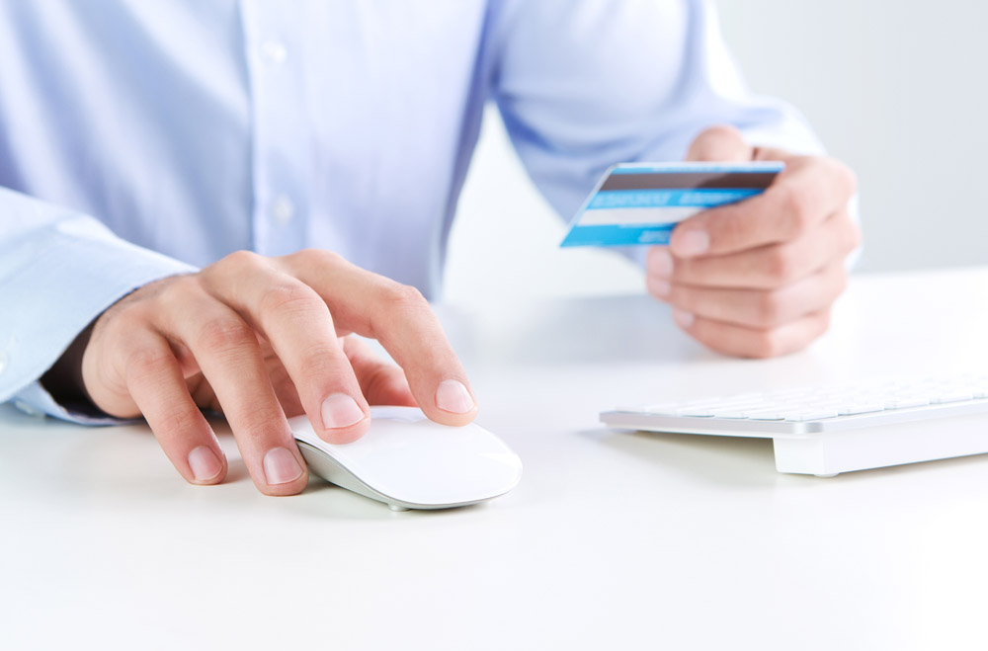
INTRODUCTION
Fundraising is the process of collecting money as donations, for a cause from, individuals and businesses. A person who raises the money from them is known as a fundraiser.
It was usually used to gather money for non-profit organizations, but, over the years fundraising has evolved a lot and it is now used to fund various important causes.

Slide 3
Proposed
Work
A fundraiser website with an aim to raise funds for various problem that people face due to unwanted circumstances
Where the person willing to donate and help can directly donate the amount of his/her choice for the cause
And those who are in need for some help can contact us and express their problems so that certain measures can be taken to help them.
In the current situation, people willing to donate and people who need help both can benefit from this website by online means

Slide 4




.
Types of Donations
HOME PAGE
Medical Aid
OUR SEVICE
ABOUT US
NGO'S
CONTACT US
DONATION PAGE
EDUCATION
NATURAL CALAMITIES

Slide 5
Work Done
“It's not how much we give but how much love we put into giving.”
Home
Page
1
About us page , Service page, Contact us page and Donate Us page
2
Services
Services provided by us : NGO's , Medical aid , Education ,Natural calamities.
3
Donate
now
This page includes donation type and the details of
the Donor.(Bank Details)
Add your words here according to your need to draw the text box size
Add your words here according to your need to draw the text box size
KEY ORDS

Slide 6

Website | Author/ Developer | Pros | Cons
Ketto.org | Varun Sheth, Kunal Kapoor | Allows users to create fundraisers according to their needs | this website is mainly for medical purpose
milaap.org | Mayuk Choudhary, Anoj Vishwananthan,Sourabh Sharma | They allow users to lend money to small businesses that can be repayed later | Works on medical fundraising and lending money to small businesses

Slide 7

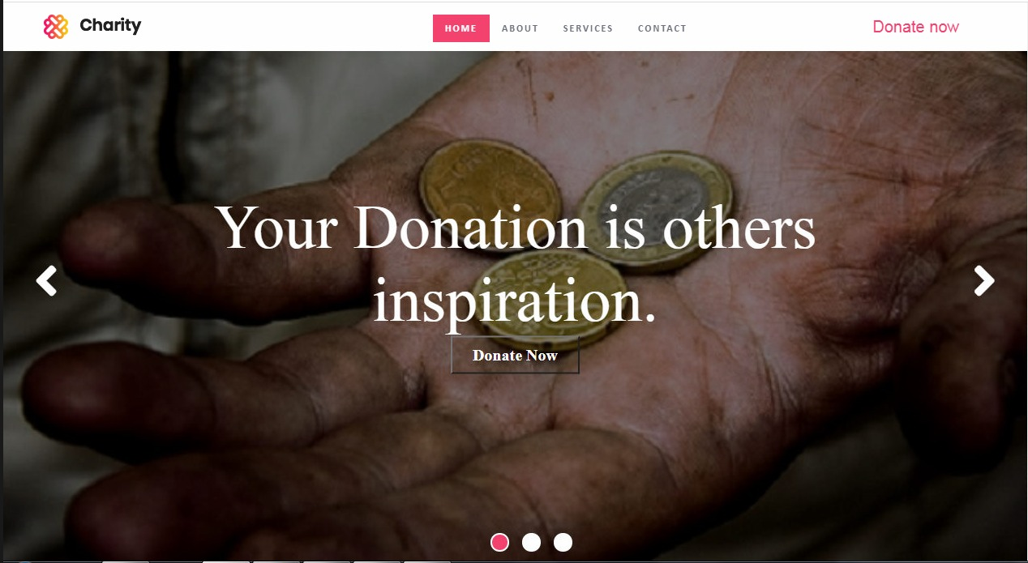
.
Home Page

Slide 8
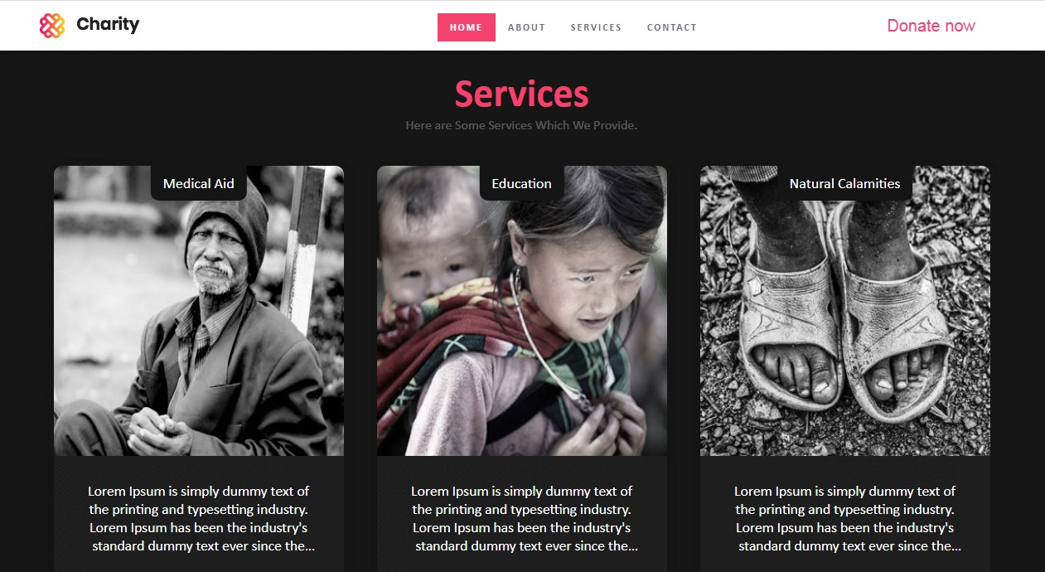
.
Service Page

Slide 9
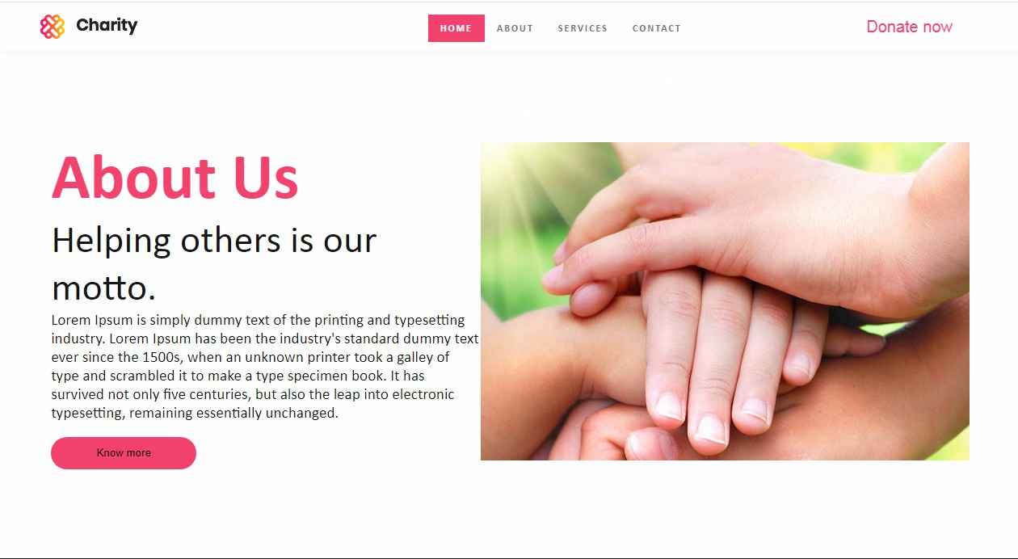
.
About Us

Slide 10
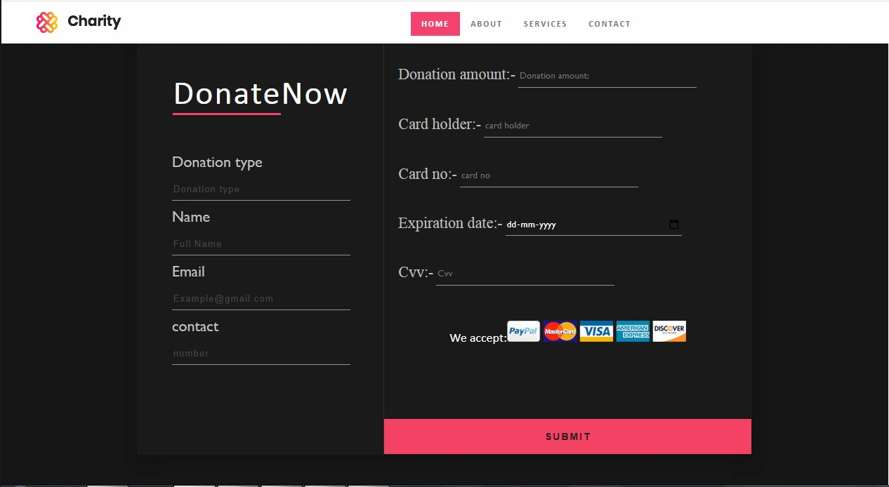
.
Dontaion Details

Slide 11

Thank You
A

